Slide 1

Topological Exploration of Human
Prefrontal Cortex Development Single-Cell RNA-seq Data
Martin Echavarria Galindo
Department of Chemical and Biological Engineering, HKUST

Slide 2
Lecture Contents
Introduction: Human Prefrontal Cortex Development
Methods: Single-Cell RNA-seq Analysis Pipeline
Results and Discussion
Conclusions

Slide 3
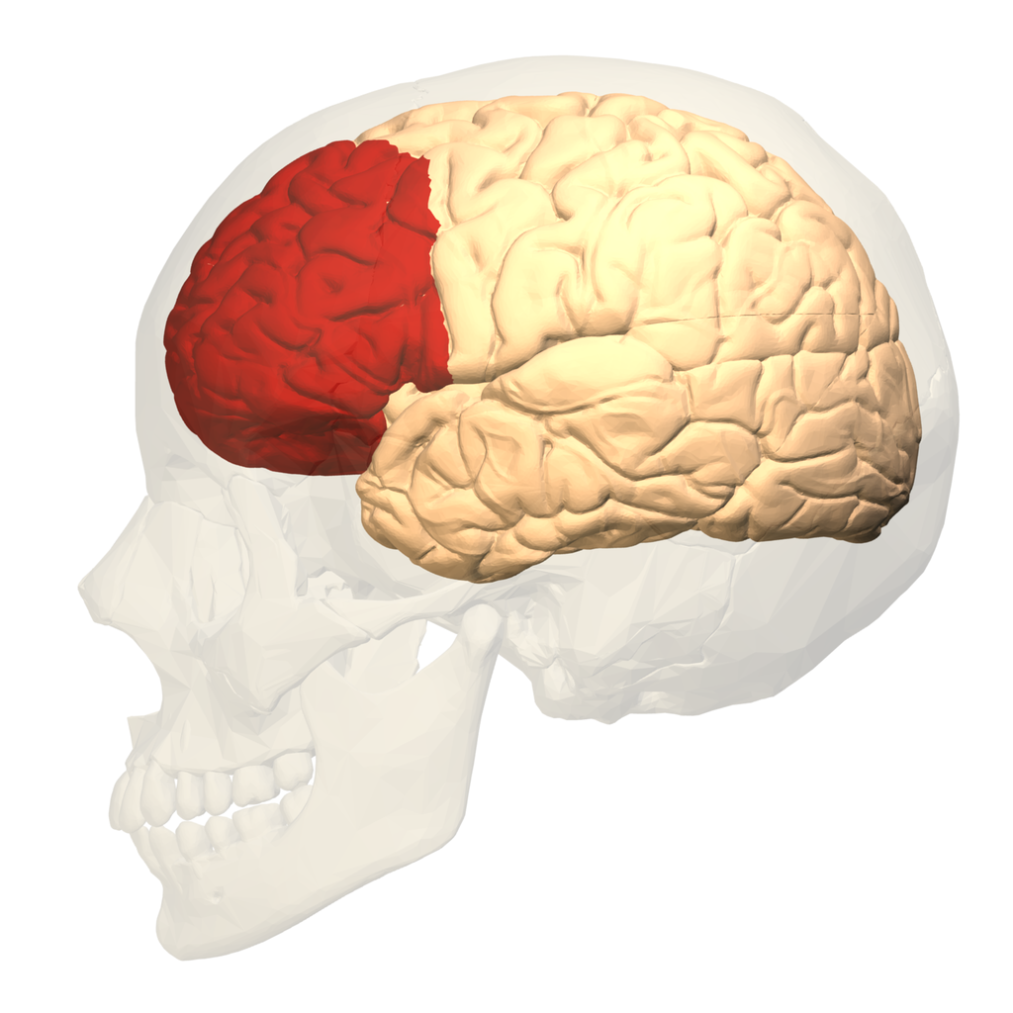
Topological Exploration of Human Prefrontal Cortex Development Single-Cell RNA-seq Data
Introduction
Human Prefrontal Cortex and Its Development
The prefrontal cortex is a key region located in the frontal lobe of the mammalian brain that has been linked to high-order biological functions such as memory, social behavior, planning and speech. Understanding its development may help the scientific community understand the cause of numerous cognitive and neurodevelopmental disorder.
Disease related to abnormal development of the prefrontal cortex:
Attention deficit hyperactivity disorder (ADHD)
Depression
Schizophrenia
Bipolar disorder
Location of the prefrontal cortex in the human brain.
From:https://en.wikipedia.org/wiki/Prefrontal_cortex#/media/File:Prefrontal_cortex_(left)_-_lateral_view.png

Slide 4
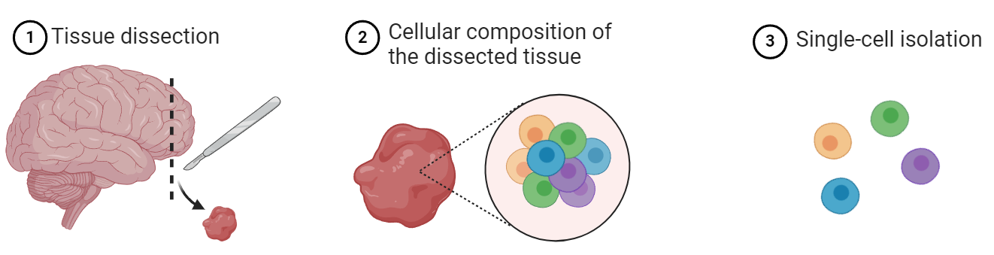
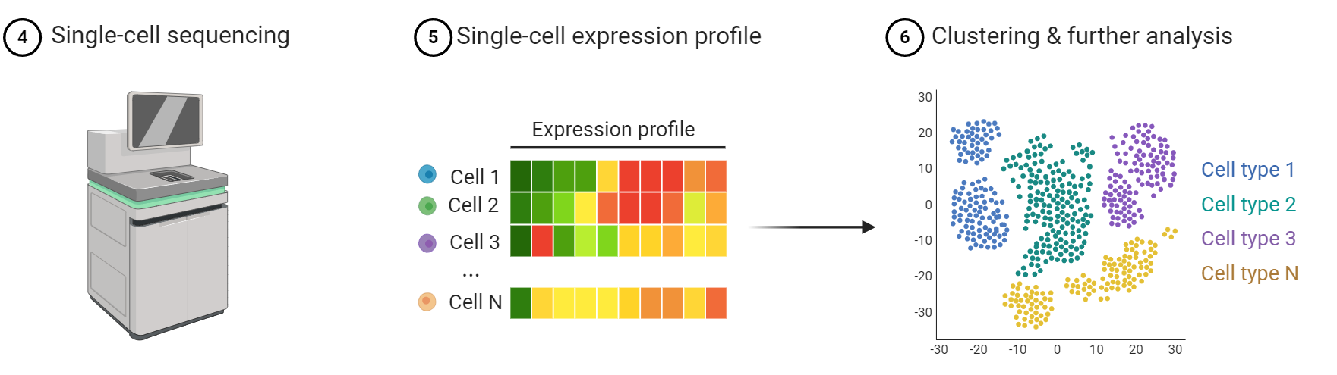
Topological Exploration of Human Prefrontal Cortex Development Single-Cell RNA-seq Data
Introduction
Single-Cell RNA Sequencing
In recent years, single-cell RNA sequencing (scRNA-seq) has emerged as a powerful biological tool for analyzing transcriptional dynamics during tissue development. By obtaining transcriptional profiles at the single-cell level, scRNA-seq achieves unparalleled specificity.
Problem:
High-dimensional nature of the single-cell transcriptional profiles
Typical scRNA-seq pipeline.

Slide 5
Topological Exploration of Human Prefrontal Cortex Development Single-Cell RNA-seq Data
Introduction
Research Objectives
This project aims to use single cell transcriptomics and topological analysis methods to achieve a preliminary characterization of the major cell types that take part in prefrontal cortex development and identify specific developmental trajectories that may occur during cortical development.

Slide 6
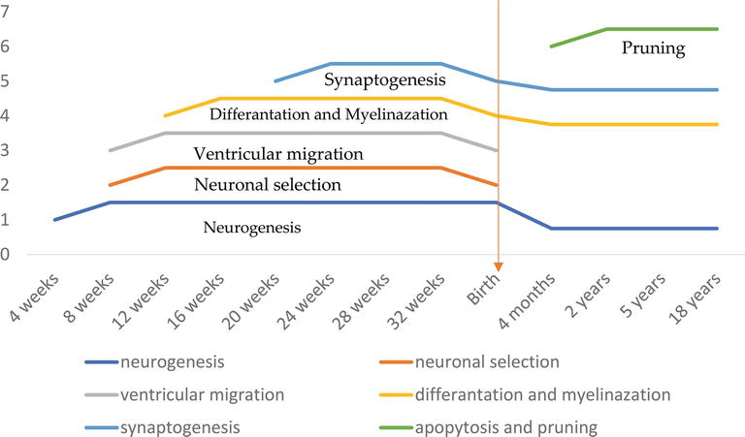
Topological Exploration of Human Prefrontal Cortex Development Single-Cell RNA-seq Data
Introduction
Dataset
This study makes use of the scRNA-seq dataset previously collected by Zhong et al. (2018). This dataset describes the gene transcription profiles of 2,394 single cells of the prefrontal cortex extracted at different stages (gestational weeks 8 to 26) of embryonic development from fetal cortical tissue extracted after elective pregnancy termination procedures.
Timespan considered
Timeline for the key developmental processes in the formation of the prefrontal cortex.
(Uytun, 2018)

Slide 7
Lecture Contents
Introduction: Human Prefrontal Cortex Development
Methods: Single-Cell RNA-seq Analysis Pipeline
Results and Discussion
Conclusions

Slide 8
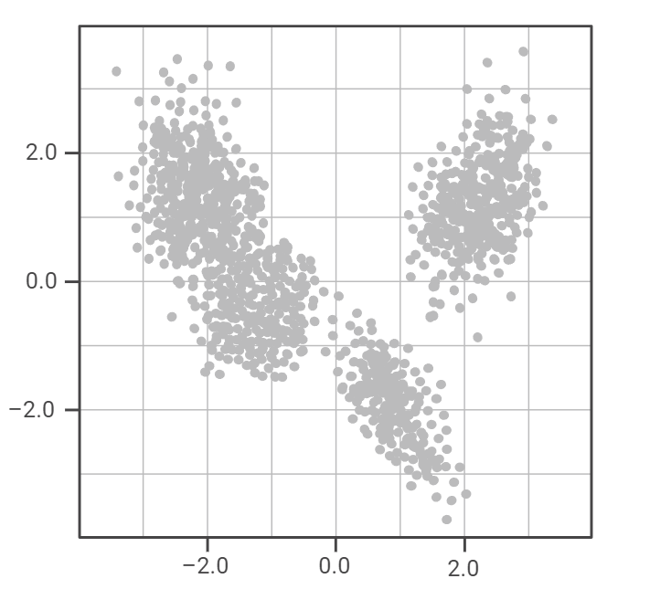
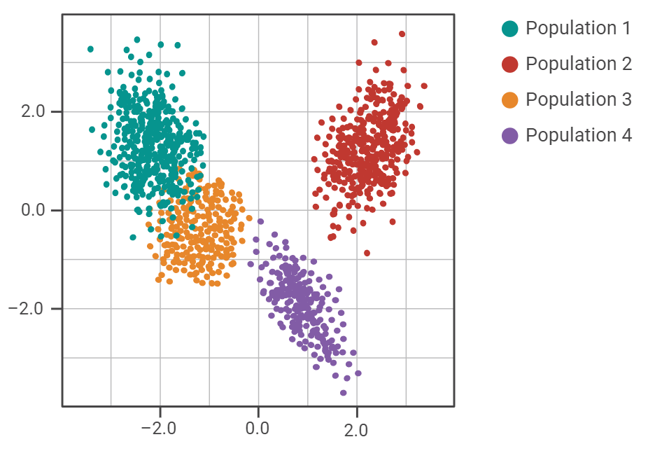
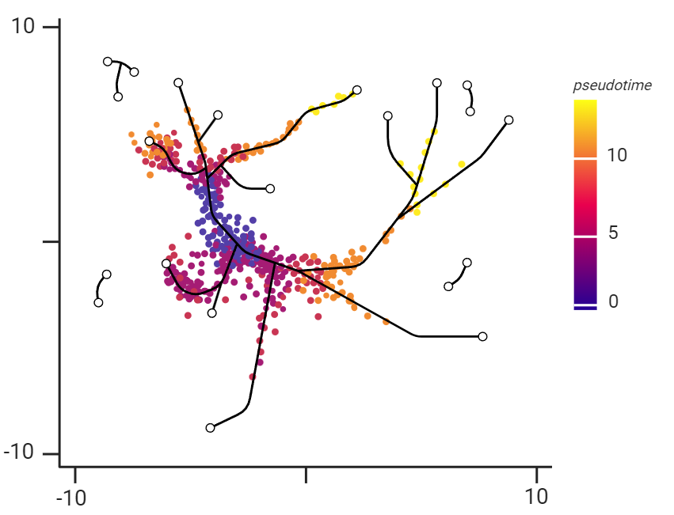
Topological Exploration of Human Prefrontal Cortex Development Single-Cell RNA-seq Data
Methods
Single-Cell RNA Sequencing Analysis Pipeline
Dimensionality Reduction and Data Visualization
Data Clustering and Annotation
Developmental Trajectories Determination
Techniques Used:
PCA
t-SNE
UMAP
Techniques Used:
K-Nearest Neighbors (KNN)
Leiden Clustering Algorithm
Techniques Used:
Partition-Based Graph Abstraction (PAGA)

Slide 9
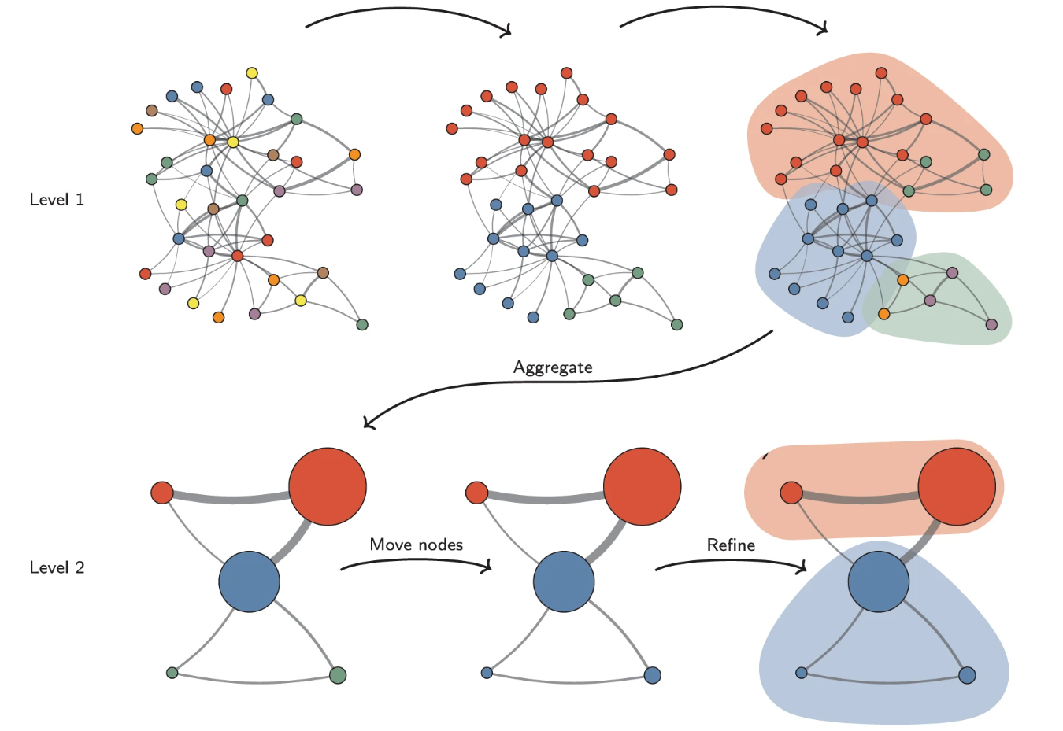
Topological Exploration of Human Prefrontal Cortex Development Single-Cell RNA-seq Data
Method
Leiden Clustering Algorithm
The main goal of the Leiden algorithm is to optimize the modularity of the graph. This process happens in three main steps:
Local moving: Move nodes to maximize modularity.
Refinement: Break communities into smaller sub-communities.
Aggregation: Create new network with communities as nodes, repeat process.
KNN Graph
Leiden Clustering Algorithm Pipeline.
(Traag et al., 2019)

Slide 10
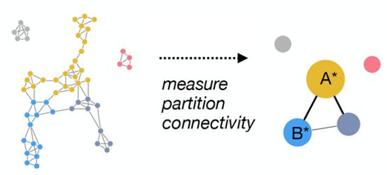
Topological Exploration of Human Prefrontal Cortex Development Single-Cell RNA-seq Data
Method
Partition-Based Graph Abstraction Algorithm
The partition-based graph abstraction (PAGA) algorithm creates a simplified graph where each node represents a cluster of cells, and edges are drawn between clusters based on the connections between cells in the original neighborhood graph. This abstracted graph retains the essential structure and branching trajectories of the data while reducing complexity.
PAGA algorithm calculation of the denoised topology of the data.
(Wolf et al. 2019)

Slide 11
Lecture Contents
Introduction: Human Prefrontal Cortex Development
Methods: Single-Cell RNA-seq Analysis Pipeline
Results and Discussion
Conclusions

Slide 12
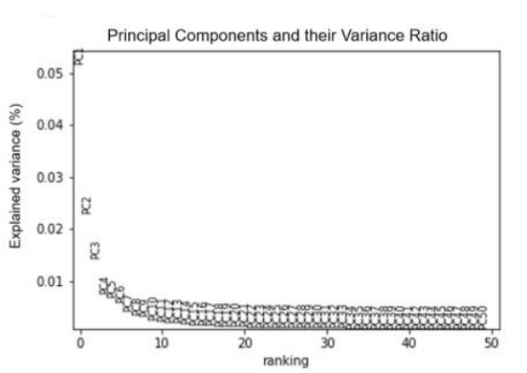
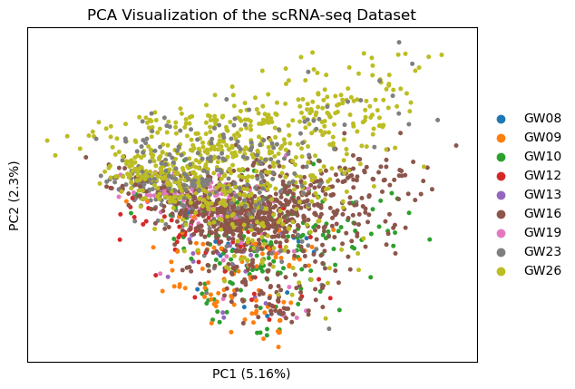
Topological Exploration of Human Prefrontal Cortex Development Single-Cell RNA-seq Data
Results and Discussion
Dimensionality Reduction Using PCA
The separation of the dataset through PCA was suboptimal, making it challenging to visualize cell heterogeneity. This limitation is likely attributed to complex non-linear relationships in the transcriptomic data that PCA may not capture effectively.
A
B
Dimensionality Reduction using PCA.
(A) Data visualization using the first two PCA components and color-coded according to the sample extraction time (Gestation week, GW) (B) Percentage of the explained variance of the first 50 PCA components.

Slide 13
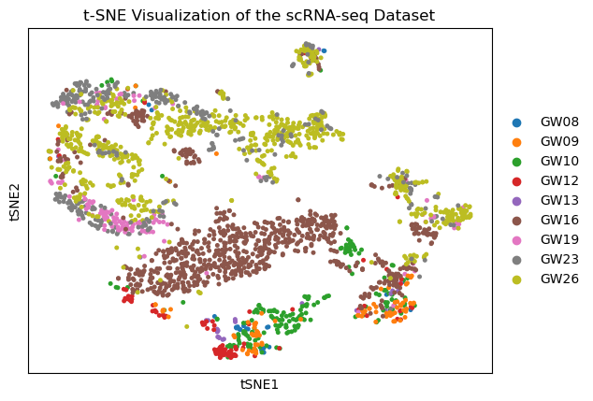
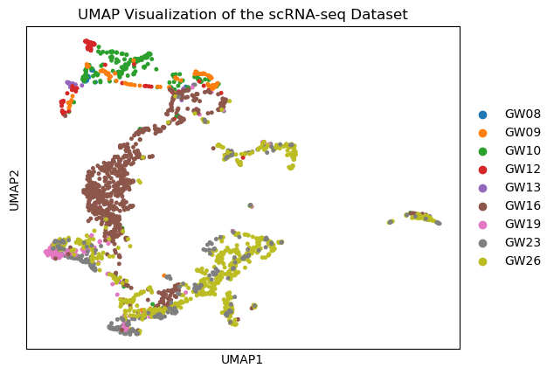
Topological Exploration of Human Prefrontal Cortex Development Single-Cell RNA-seq Data
Results and Discussion
Dimensionality Reduction Using t-SNE and UMAP
A
B
Dimensionality Reduction using t-SNE and UMAP..
(A) Data visualization with t-SNE (B) Data visualization with UMAP. The data was first reduced using the first 15 PCA components and then used to calculate the two plots.

Slide 14
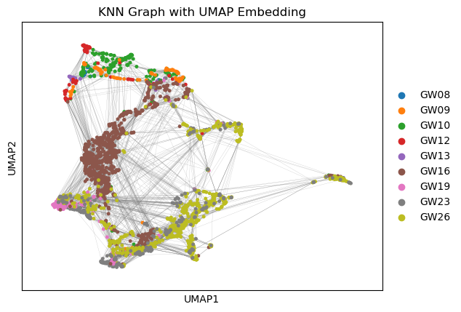
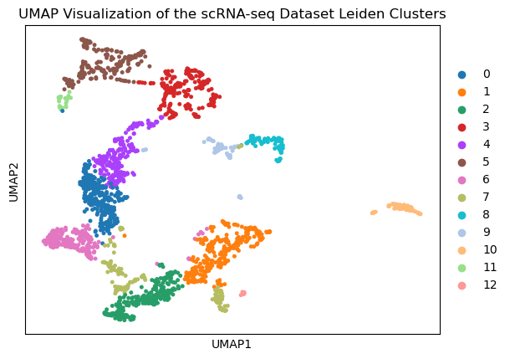
Topological Exploration of Human Prefrontal Cortex Development Single-Cell RNA-seq Data
Results and Discussion
Data Clustering Through Leiden
A
B
Data Clustering using the Leiden algorithm..
(A) KNN graph embedded in UMAP (B) Resulting data partition after clustering.

Slide 15
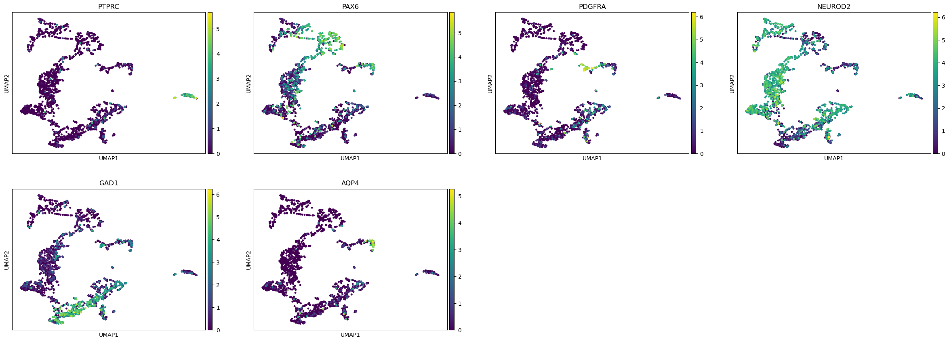
Topological Exploration of Human Prefrontal Cortex Development Single-Cell RNA-seq Data
Results and Discussion
Marker Genes Expression in the Dataset
Marker genes representative of key cell populations in the prefrontal cortex developmental stage:
PTPRC: Microglia
PAX6: Neural progenitor cells (NPCs)
PDGFRA: Oligodendrocyte progenitor cells (OPCs)
GAD1: Interneurons
AQP4: Astrocytes
NEUROD2: Excitatory neurons
Expression of key marker genes for specific cell populations

Slide 16
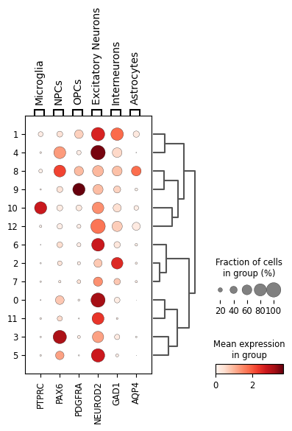
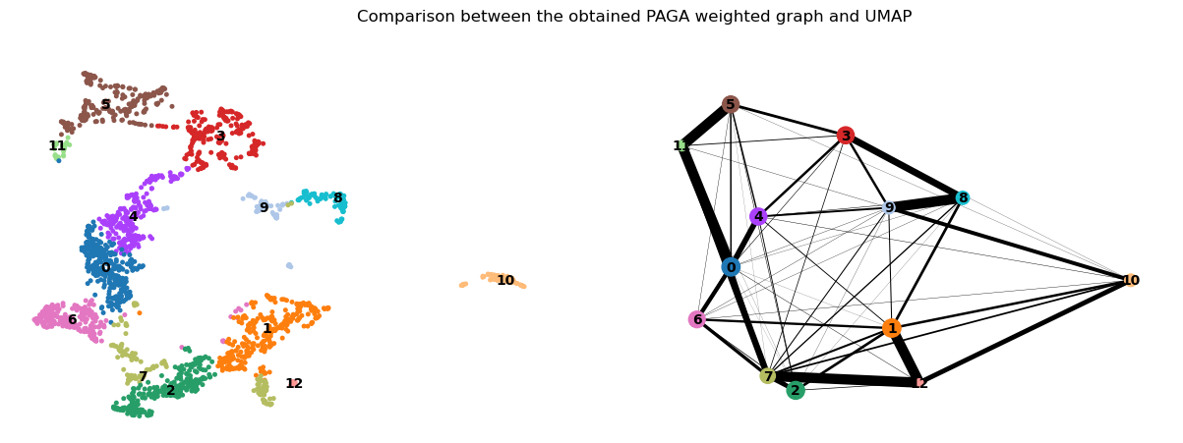
Topological Exploration of Human Prefrontal Cortex Development Single-Cell RNA-seq Data
Results and Discussion
Cluster Characterization
UMAP Plot
Expression of key marker genes per cluster and inter-cluster relationship

Slide 17
Topological Exploration of Human Prefrontal Cortex Development Single-Cell RNA-seq Data
Results and Discussion
PAGA Graph Calculation
UMAP Plot
PAGA Weighted Plot
Comparison between the obtained PAGA weighted graph and UMAP

Slide 18
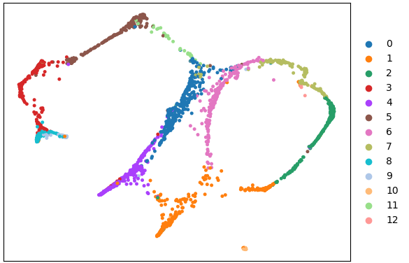
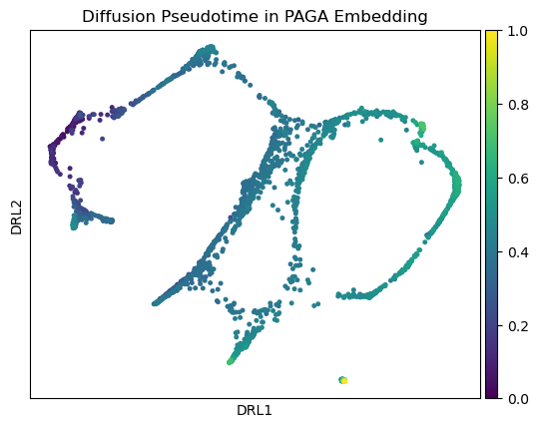
Topological Exploration of Human Prefrontal Cortex Development Single-Cell RNA-seq Data
Results and Discussion
Trajectory Estimation
A
B
Force-Directed Graph Embedding of the PAGA Graph
Force-Directed Graph with Diffusion Pseudotime
Single cell trajectory with diffusion pseudotime.
(A) Force-directed graph with PAGA embedding and cluster annotation. (B) Force-directed graph with PAGA embedding and diffusion pseudotime

Slide 19
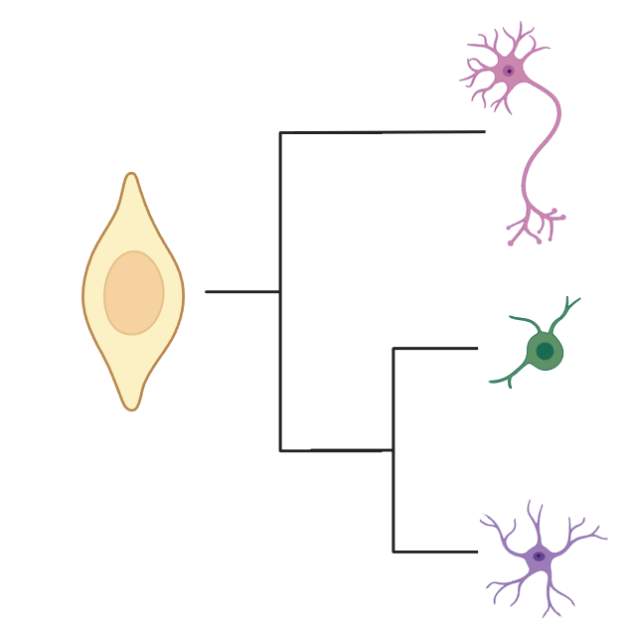
Topological Exploration of Human Prefrontal Cortex Development Single-Cell RNA-seq Data
Results and Discussion
Developmental Trajectory in the Prefrontal Cortex
Excitatory Neurons
Suggested timeline for the neural cell development:
Interneurons
Microglia
Interneurons
Astrocytes
Excitatory Neurons and OPCs
Neural Progenitor Cells
Neural Progenitor Cells
Excitatory Neurons
Astrocytes
Suggested trajectory for the neural cell development:
Oligodendrocyte Progenitor Cells
Oligodendrocyte Progenitor Cells
Microglia
Neural Progenitor Cells
Astrocytes

Slide 20
Topological Exploration of Human Prefrontal Cortex Development Single-Cell RNA-seq Data
Results and Discussion
Developmental Trajectory in the Prefrontal Cortex
Excitatory Neurons
Suggested timeline for the neural cell development:
Interneurons
Microglia
Interneurons
Astrocytes
Excitatory Neurons and OPCs
Neural Progenitor Cells
Neural Progenitor Cells
Excitatory Neurons
Astrocytes
Suggested trajectory for the neural cell development:
Oligodendrocyte Progenitor Cells
Oligodendrocyte Progenitor Cells
Microglia
Neural Progenitor Cells
Astrocytes

Slide 21
Lecture Contents
Introduction: Human Prefrontal Cortex Development
Methods: Single-Cell RNA-seq Analysis Pipeline
Results and Discussion
Conclusions

Slide 22
Topological Exploration of Human Prefrontal Cortex Development Single-Cell RNA-seq Data
Conclusions
This project employed standard single-cell topological analysis pipelines and t-SNE and UMAP for visualization and spatial characterization.
Several common cortical neural cell types were identified, and the differentiation mechanisms and timing were estimated using clustering techniques, PAGA, and diffusion pseudotime calculations.
The results align with the original findings of Zhong et al. (2018) but also reveals discrepancies.
Limitations
This discrepancy may be attributed to several factors, one possible explanation being that PAGA is highly sensitive to the choice of parameters, such as the number of clusters and resolution, which can significantly impact the inferred trajectories.
scRNA-seq data tends to be noisy and may lead to misleading results if improper data preprocessing procedures are applied.
Further comparison with other trajectory determination tools like Monocle or Slingshot is needed to verify the obtained conclusions in this project.

Slide 23
Topological Exploration of Human Prefrontal Cortex Development Single-Cell RNA-seq Data
References
Uytun, M. C. (2018). Development period of prefrontal cortex. Prefrontal Cortex. 10.5772/intechopen.78697
Zhong, S., Zhang, S., Fan, X., Wu, Q., Yan, L., Dong, J., Zhang, H., Li, L., Sun, L., Pan, N., Xu, X., Tang, F., Zhang, J., Qiao, J., & Wang, X. (2018). A single-cell RNA-seq survey of the developmental landscape of the human prefrontal cortex. Nature, 555(7697), 524–339 528. 10.1038/nature25980
Wolf, F. A., Hamey, F. K., Plass, M., Solana, J., Dahlin, J. S., Göttgens, B., Rajewsky, N., Simon, L., & Theis, F. J. (2019). PAGA: graph abstraction reconciles clustering with trajectory inference through a topology preserving map of single cells. Genome Biology, 20(1), 59. 10.1186/s13059-019-1663-x
Traag, V. A., Waltman, L., & van Eck, N. J. (2019). From Louvain to Leiden: Guaranteeing well-connected communities. Scientific Reports, 9(1). 10.1038/s41598-019-41695-z

Slide 24


Thank you!
Contact information:
Martin Echavarria Galindo
Department of Chemical and Biological Engineering, HKUST
Hong Kong SAR, China
Email: megaa@connect.ust.hk

